Slide 1
AllStar Asterisk Repeater
Tom Davis, KB7HTA

Slide 2
Asterisk – AllStar
1999 – Mark Spencer (Huntsville, AL) started a Linux software company called Digium
The company grew and needed phone services – So they wrote their own PBX software called Digium/ Asterisk in 2001. Today, the company remains the maintainer and sponsor of the Asterisk project, with its open source code available free of charge.
Asterisk now includes some of the most talented minds from over 170 countries, with approximately 2 million servers running the software.

Slide 3
Radio VOIP – History of app_rpt
A melding of Asterisk PBX and Linux-based repeater control code app_rpt was written to allow additional hardware/applications to extend its capability
The app_rpt application was written by Jim Dixon, WB6NIL, and Steve Rodgers, WA6ZFT, in the mid 2000's, to fulfill their need for a repeater controller and VOIP interface
Original system used a Quad PCI radio interface card and later a Universal Radio Interface or sound FOB
Presently AllStar makes use of this system for repeaters

Slide 4
Comparison of AR VOIP Systems
Echolink -- Free
Not open source and limited App Interface
Low audio quality – GSM – Half Duplex
Easy to use with a large user base
Limited capability
Not the best choice for computer linking
Computer or phone originated
Stable, but has been around for a while

Slide 5
Comparison of AR VOIP Systems
IRLP – Internet Linking Protocol
Not open source – Requires a board purchase
Good audio quality – Adaptive Differential Pulse-Code Modulation ADPCM – Half Duplex
Smaller user base
Only radio originated
Limited capability
Limited connectability

Slide 6
Comparison of AR VOIP Systems
AllStar
Open source – Free
Excellent audio quality – Full duplex
Choice of codecs
Radio, phone or computer originated
Endless capability and connectability, low cost
Bridges for Echolink, D-Star, C4FM, DMR, etc.
Requires some LINUX knowledge

Slide 7
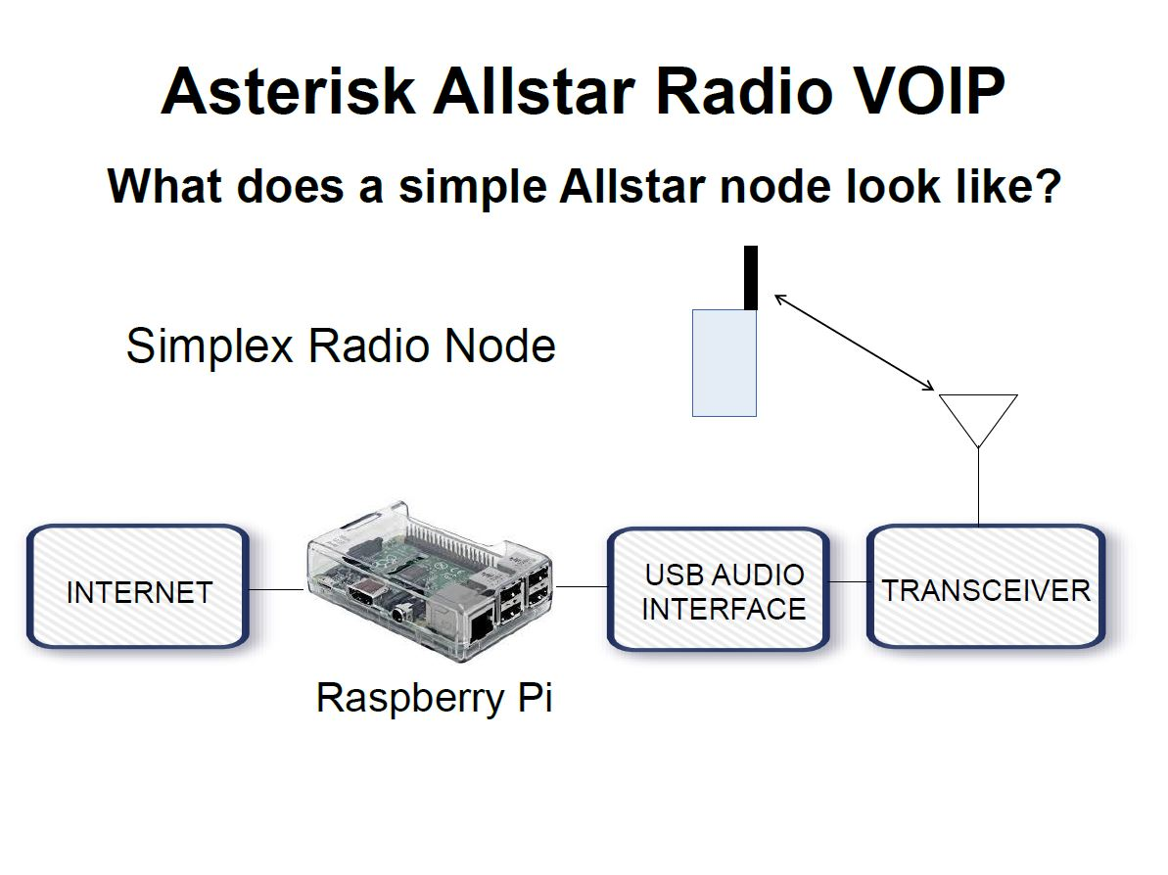
AllStar Node Example

Slide 8
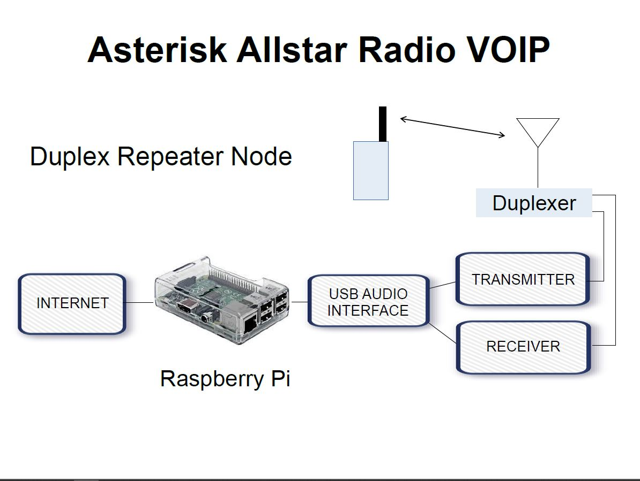
AllStar Node Example

Slide 9
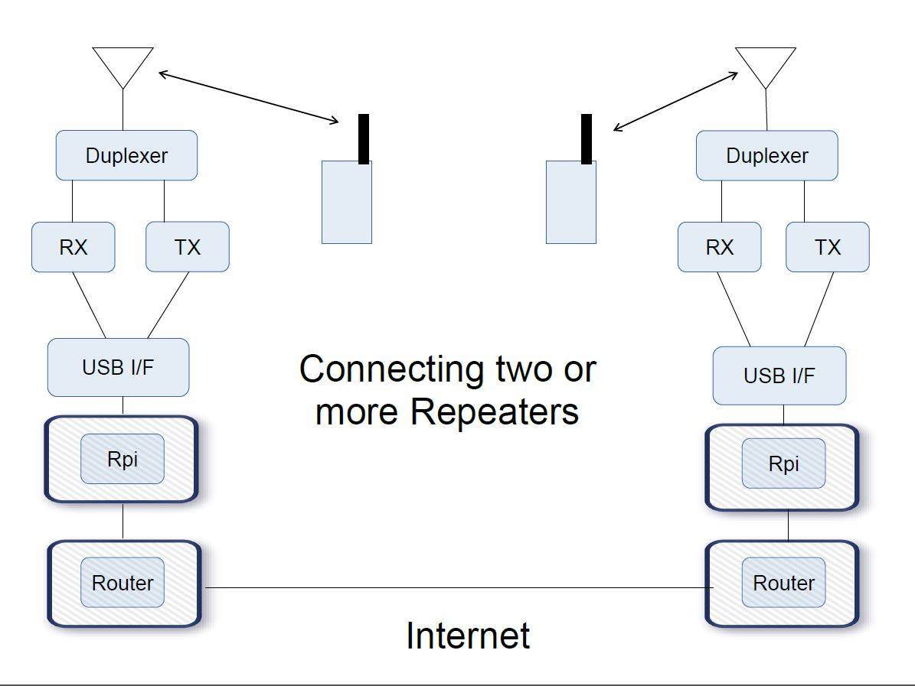
AllStar Node Example

Slide 10
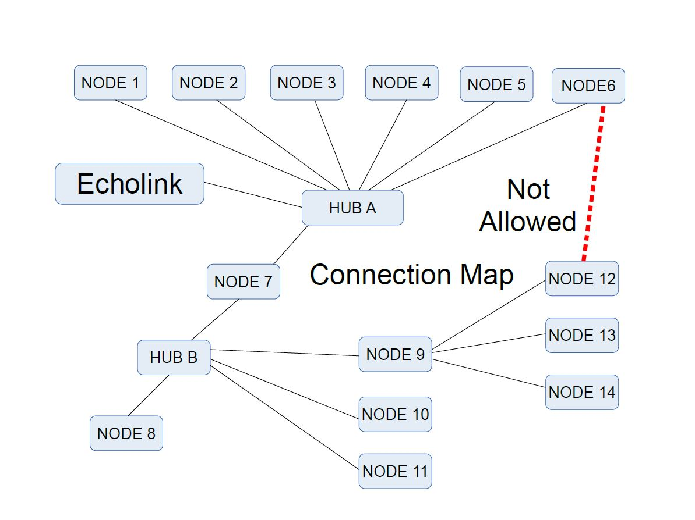
AllStar Connection Map

Slide 11
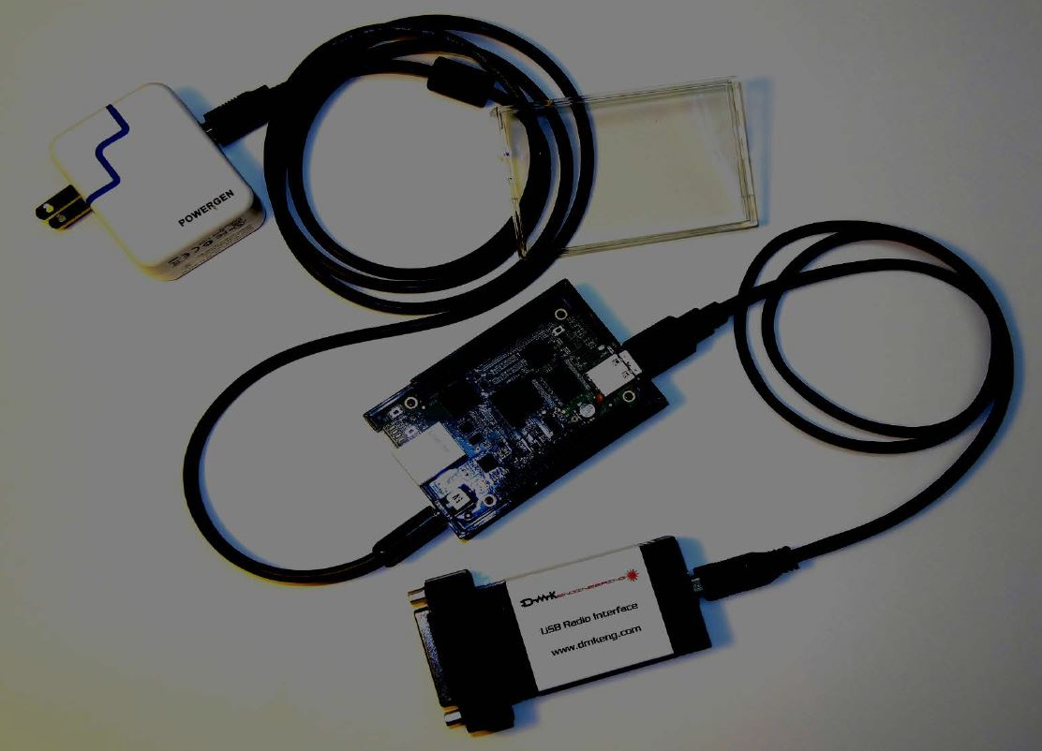
Building AllStar Node Hardware

Slide 12
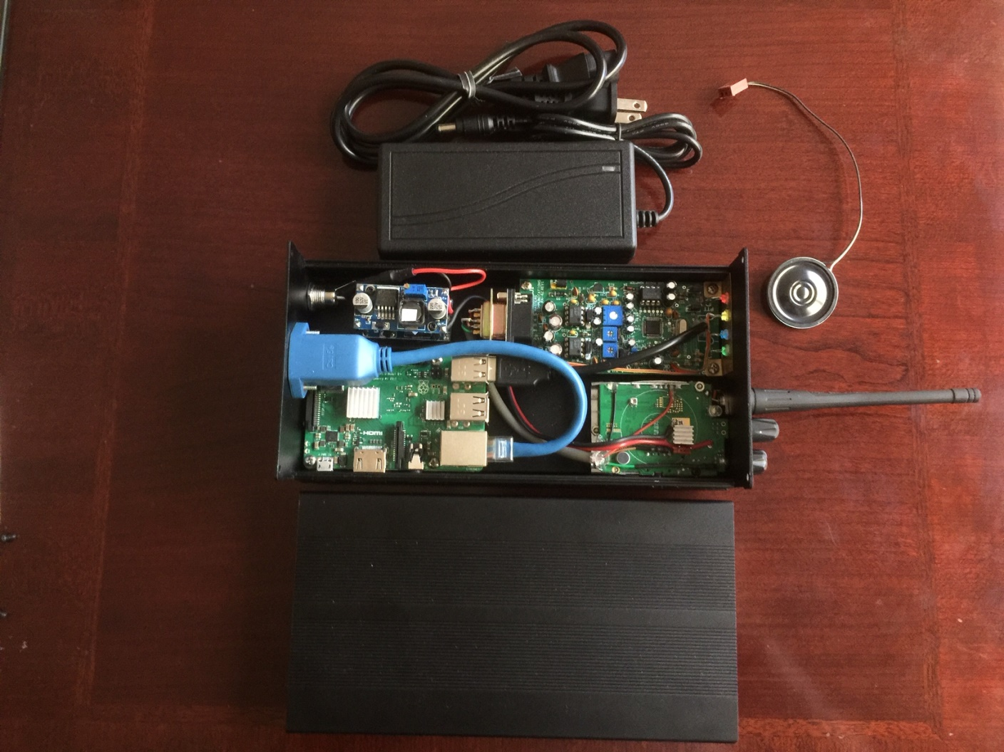
Building AllStar Node Hardware

Slide 13
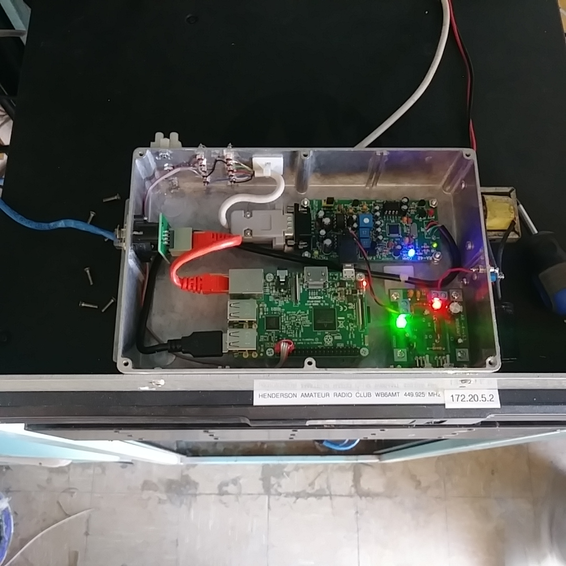
Building AllStar Node Hardware

Slide 14
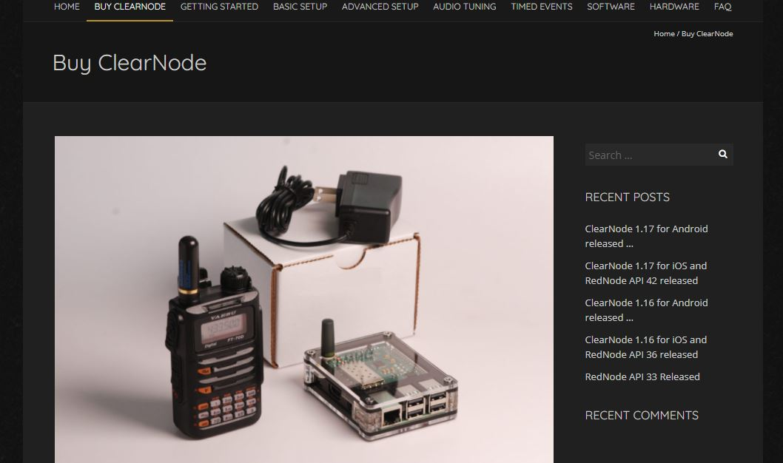
Buy an AllStar Node – Clear Node

Slide 15
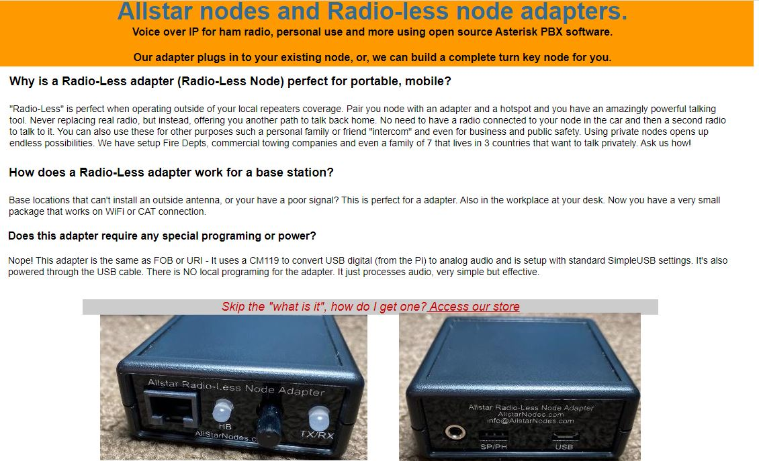
Buy an AllStar Node – Radioless

Slide 16
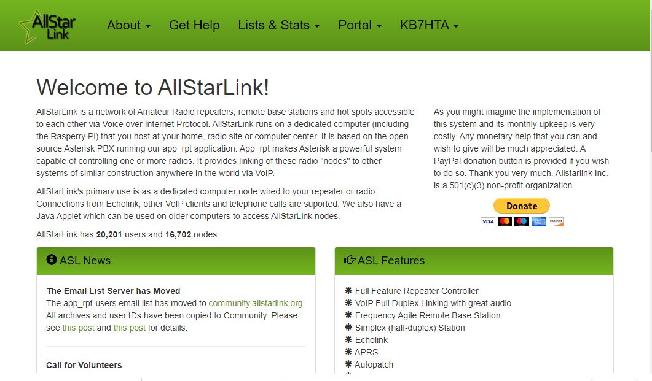
Website 1 – AllstarLink.org

Slide 17
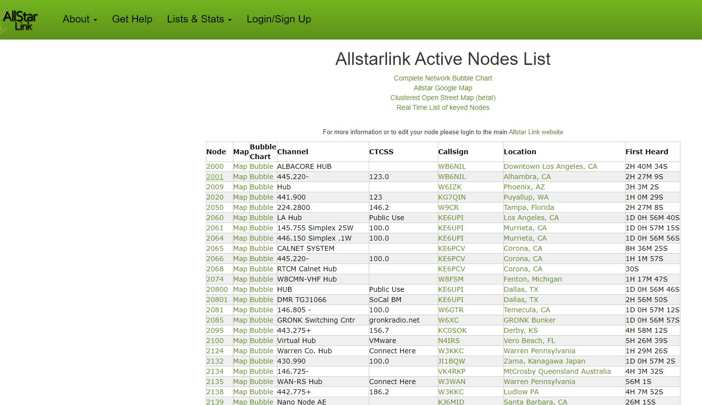
AllStarLink Node List

Slide 18
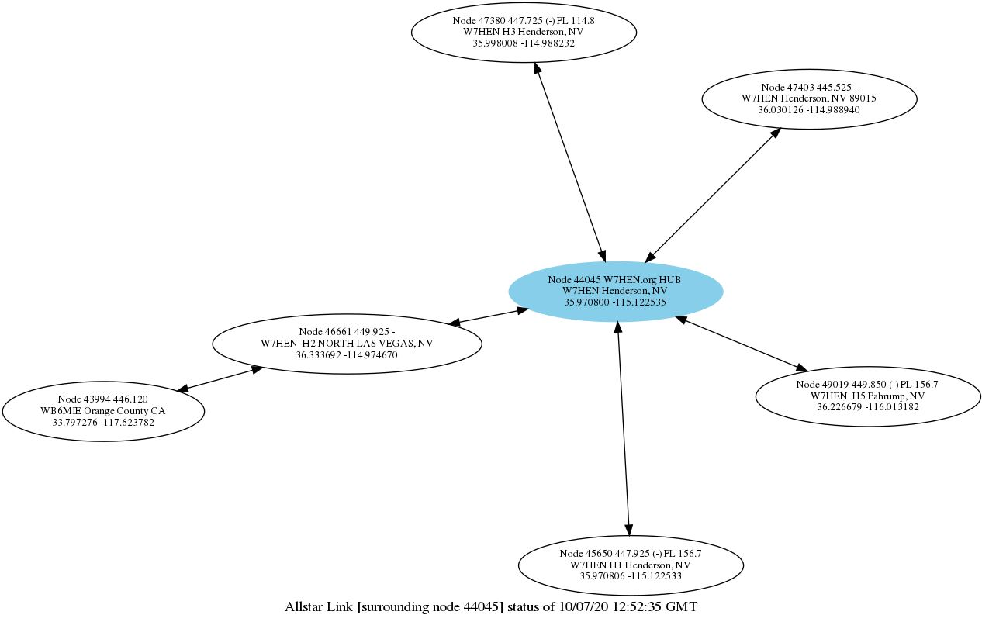
AllStar Connection Bubble Chart

Slide 19
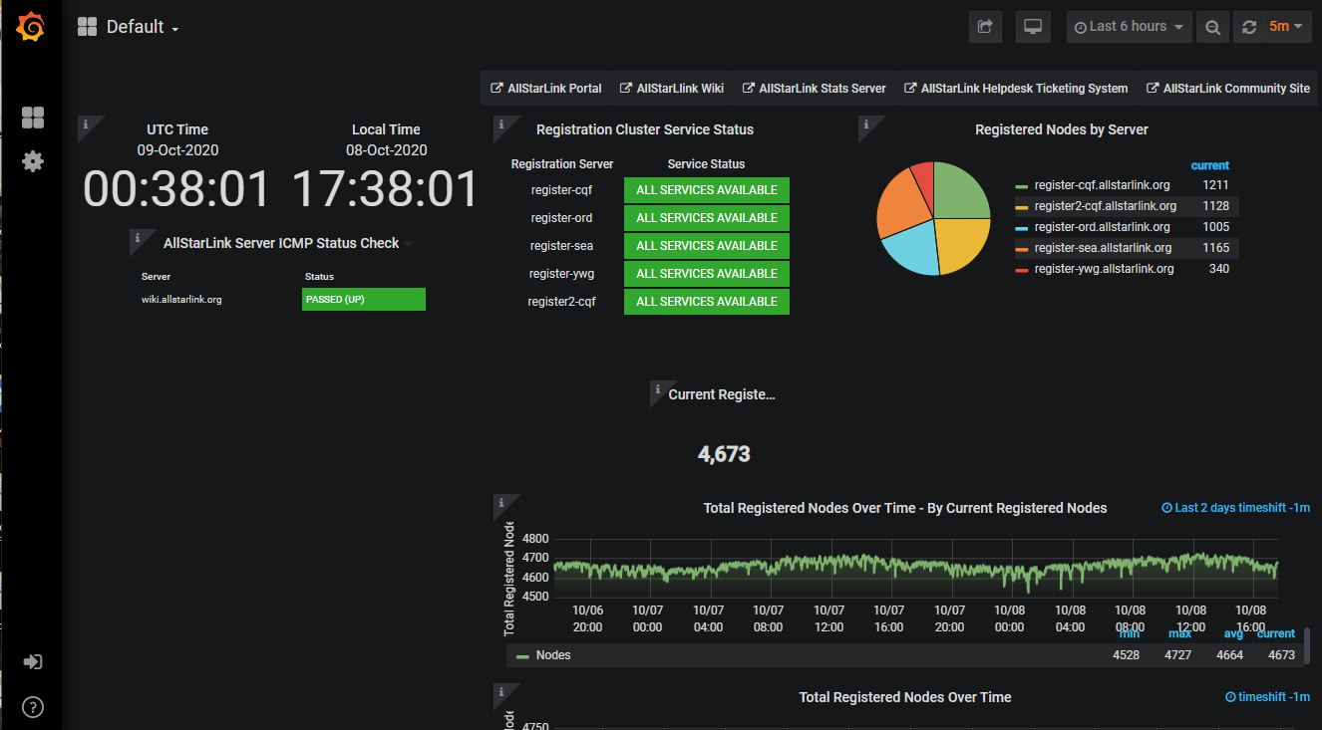
AllStarLink Status Page

Slide 20
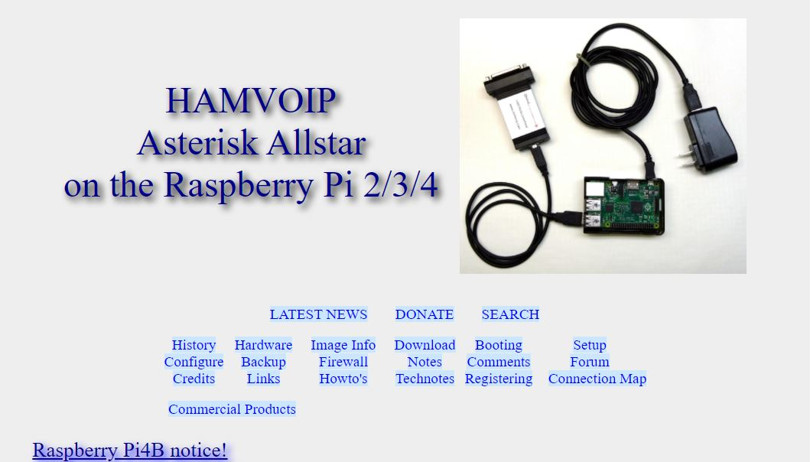
Website 2 – HamVOIP.org

Slide 21
The End
Get out there, and add an AllStar Node to your shack
Presentation available on KB7HTA Website
Questions?

