Slide 1
Amateur Radio Mesh Networking
Part 2
By Tom Davis – KB7HTA

Slide 2
What is an AR Mesh Network?
In many ways, it is the same as the Internet
What you can do on the Internet you can do on a private mesh network.
Websites Mesh Node Status
Servers LVMesh
Search Engines
Chat
IP Cameras
VoIP Telephones
Emergency Services - WinLink

Slide 3
What It Is Not?
Not for conducting business (Part 97 Rules)
24/7 Access – No guarantees!

Slide 4
Overview of the System?
The AREDN™ acronym stands for “Amateur Radio Emergency Data Network” and it provides a way for Amateur Radio operators to create high-speed ad hoc Data Networks for use in Emergency and service-oriented communications.
Mission: The primary goal of the AREDN® project is to empower licensed amateur radio operators to quickly and easily deploy high-speed data networks when and where they are needed.

Slide 5
Overview Continued
The amateur radio community is able to meet these high-bandwidth digital communication requirements by using FCC Part 97 amateur radio frequency bands to send digital data between devices which are linked with each other to form a self-healing, fault-tolerant data network. Some have described this as an amateur radio version of the Internet. Although it is not intended for connecting people to the Internet, an AREDN™ mesh network will provide typical Internet or intranet-type applications to people who need to communicate across a wide area during an emergency or community event.

Slide 6
Types of Links

Slide 7
Nevada Open Road Challenge NORC
Goal: Provide a high speed data network between Check Point 7 and the Start/Finish Line of the NORC, near Hiko, NV; and in addition provide VoIP telephone communications, and live video of the race at Check Point 7 and Check Point 8.

Slide 8
Network Planning Tools
Google Maps - NORC Race Course
Google Maps – NORC Check Point 7 Map
Topographical Maps - USGS TopoView
Link Calculator - Ubiquiti Link Calculator
Google Maps - NORC Mesh Network

Slide 9
NORC Race Course Map

Slide 10
NORC Check Point 7 Map

Slide 11
Link Calc CP7 to NN High

Slide 12
NORC Mesh Network Map

Slide 13
Equipment Construction

Slide 14
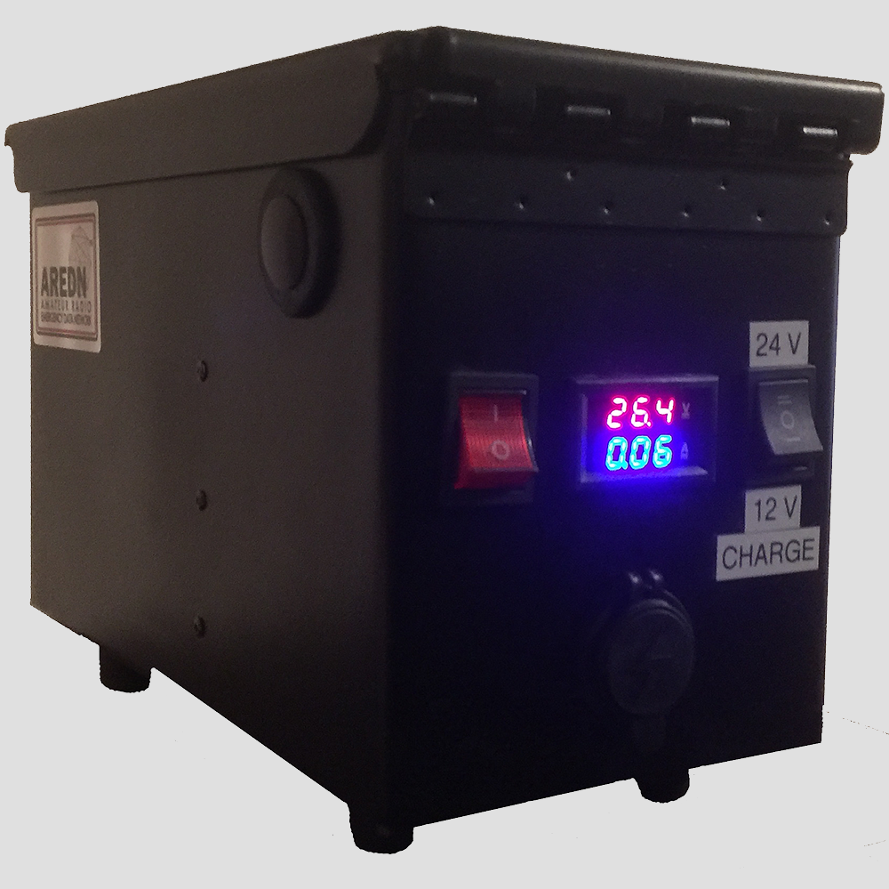
Power Source
Link: Power Box Project

Slide 15
Relay Node(s)

Slide 16
Relay Node Transport Bag

Slide 17
Race Day

Slide 18
Finish/Start Line Manned by Tom Davis, KB7HTA

Slide 19
Lower Fossil Relay Node Manned by Tristan Davis

Slide 20
Check Point 8 Manned by Steve Forinella, N6SFX

Slide 21
North Narrows High Relay Node Manned by Thomas Turner, KI6CCW

Slide 22
North Narrows High Relay Node Manned by Thomas Turner, KI6CCW

Slide 23
Check Point 7 Manned by Wayne McGartlin, N7HWM

Slide 24
Camera Endpoint Node

Slide 25
Live Race Video

Slide 26
Checkpoint Cameras
By Thomas Turner KI6CCW
Camera Purchased on Ebay
Mounting the Camera
Camera Software
Demonstration

Slide 27
Link Example
Select a Volunteer from the Audience
Open Ubiquiti Link Calculator
Search for Street Address
Draw Link from Volunteer’s Home to Apex
Analysis of Link
Is the link possible
If so select appropriate hardware
If not what are other link options
Purchase Equipment and Install - AREDN™

Slide 28
Radios Supported by AREDN
Ubiquiti
Rocket M2/3/5
Nano Station M2/3/5
Bullet
TP-Link
CPE-210/510
CPE-220
CPE-610
MikroTik
hAP AC Lite
List: http://downloads.arednmesh.org/firmware/ubnt/html/stable.html

Slide 29
Ubiquiti Rocket M2

Slide 30
Ubiquiti NanoStation

Slide 31
Ubiquiti Bullet

Slide 32
TP-Link CPE-210

Slide 33
MikroTik hAP AC Lite

Slide 34
Antennas
Most radios come with the antenna attached to the radio, usually a sector antennas (90 °, 120°)
Others, like the Ubiquiti Rocket M2/3/5 need an antenna – advantage or disadvantage?
There are omni-directional, dish and sector (90 °, 120 °) antennas

Slide 35
Omni-Directional Antennas

Slide 36
Dish Antennas

Slide 37
Sector Antennas

Slide 38
What Now?
Part of the LVMesh Group has formed a team to deploy AREDN equipment for emergencies and public service.
Deployable Autonomous Mesh Node Project
Nevada Open Road Challenge May 17, 2020
Mesh Network Expansion to Pahrump
Mesh Network Expansion to Beacon Hill and Moapa Valley
Mesh Network Expansion LV to LA

Slide 39
Deployable Autonomous Mesh Node Project

Slide 40
DAMN Equipment Design
Power Source 2 x 20 Watt Solar Panels
Solar Battery Regulator Charge Controller
Sealed Lead Acid Battery 12 V @ 26 AH
DC-DC Power Converters 24 V, 5 V, and 3.3 V
Supports 1 - 3 nodes
CPU - Arduino Uno with Ethernet Shield
Watchdog Timer
Voltage, Current and Atmospheric Sensors
Baofeng 888 - Telemetry Xmit & DTMF Receive
More Information at DAMN Project

Slide 41
The End
Download Power Point Presentation
Stay Tuned for Part 3

