Slide 1
Amateur Radio Mesh Networking
Part 1
By Tom Davis – KB7HTA

Slide 2
What is an AR Mesh Network?
In many ways, it is the same as the Internet
What you can do on the Internet you can do on a private mesh network.
Websites
Email Servers
Search Engines
Chat Rooms
IP Cameras
VoIP Telephones
Emergency Services

Slide 3
What It Is Not?
Not for conducting business (Part 97 Rules)
24/7 Access – No grantees!

Slide 4
Overview of the System?
The AREDN™ https://www.arednmesh.org/ acronym stands for “Amateur Radio Emergency Data Network” and it provides a way for Amateur Radio operators to create high-speed ad hoc Data Networks for use in Emergency and service-oriented communications.
Mission: The primary goal of the AREDN® project is to empower licensed amateur radio operators to quickly and easily deploy high-speed data networks when and where they are needed.

Slide 5
Overview Continued
The amateur radio community is able to meet these high-bandwidth digital communication requirements by using FCC Part 97 amateur radio frequency bands to send digital data between devices which are linked with each other to form a self-healing, fault-tolerant data network. Some have described this as an amateur radio version of the Internet. Although it is not intended for connecting people to the Internet, an AREDN™ mesh network will provide typical Internet or intranet-type applications to people who need to communicate across a wide area during an emergency or community event.

Slide 6
Types of Links

Slide 7
Backbone Links
As the name implies, these links form the backbone or superhighway along which large amounts of data can travel for long distances at relatively high speed. Typically backbone or “backhaul” links are permanent installations on mountain peaks, tall buildings, or high towers. They are usually point-to-point links with large high-gain antenna systems running on reliable power sources. In some cases these links are designed with redundant radios which help ensure path protection. Backbone links can operate over distances between 10 to 30+ miles.

Slide 8
Backbone Red Mountain

Slide 9
Backbone - Apex Peak

Slide 10
Intermediate
Intermediate links bridge the gaps between endpoint nodes. Their primary purpose is to pass network data, but there may be cases where they also serve as mesh access nodes for users. Sometimes these links are call “mid-mile”, “distribution”, or “relay” nodes. They are usually installed on medium-height towers or buildings in order to achieve high signal quality with good line of sight to other intermediate nodes. Depending on conditions, intermediate links may operate over distances between 3 to 10+ miles.

Slide 11
Intermediate Link

Slide 12
End Point Links
Endpoint links are used to connect destination nodes to the mesh network. Sometimes these links are call “last mile”, “tactical”, or “terminal” nodes. Usually these nodes serve either as the originator or the final destination for network traffic. Depending on local conditions, endpoint links typically operate over distances of 3 miles or less.

Slide 13
Radios Supported by AREDN
Ubiquiti
Rocket M2/3/5
Nano Station M2/3/5
Bullet
TP-Link
CPE-210/510
CPE-220
CPE-610
MikroTik
hAP AC Lite
List: http://downloads.arednmesh.org/firmware/ubnt/html/stable.html

Slide 14
Ubiquiti Rocket M2

Slide 15
Ubiquiti NanoStation

Slide 16
Ubiquiti Bullet

Slide 17
TP-Link CPE-210

Slide 18
MikroTik hAP AC Lite

Slide 19
Antennas
Most radios come with the antenna attached to the radio, usually a sector antennas (90 °, 120°)
Others, like the Ubiquiti Rocket M2/3/5 need an antenna – advantage or disadvantage?
There are omni-directional, dish and sector (90 °, 120 °) antennas

Slide 20
Omni-Directional Antennas

Slide 21
Dish Antennas

Slide 22
Sector Antennas

Slide 23
Putting It All Together
Mission: The primary goal of the AREDN® project is to empower licensed amateur radio operators to quickly and easily deploy high-speed data networks when and where they are needed.
Design relay nodes, end point nodes and power sources

Slide 24
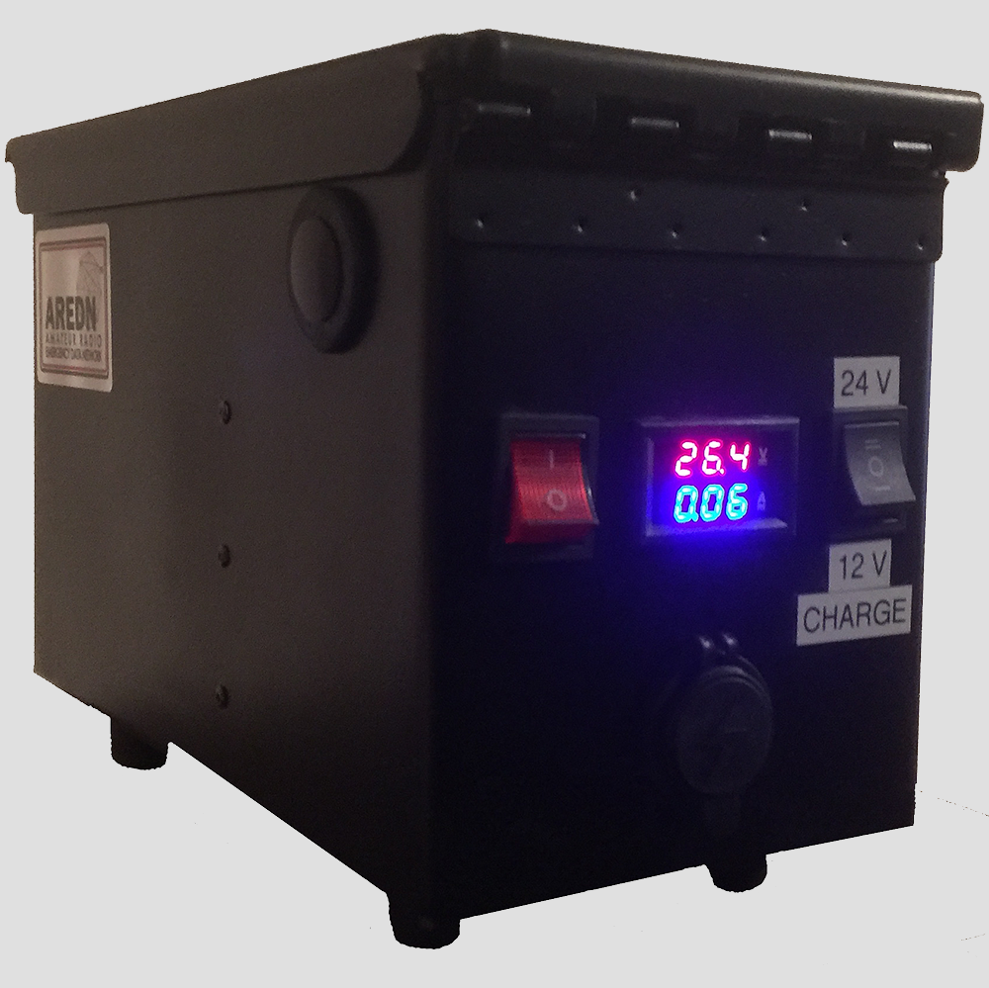
Power Source
Link: http://kb7hta.com/projects/

Slide 25
Relay Node(s)

Slide 26
End Point Node

Slide 27
What Now?
Part of the LVMesh Group has formed a team to deploy AREDN equipment for emergencies and public service.
Corporate Challenge Bicycle Race in Jean, NV on April 24, 2019
Nevada Open Road Challenge on May 19, 2019
Future deployment challenges

Slide 28
Corporate Challenge Bike Race
The team decided to deploy one of the two hilltop relay nodes just East of Jean.
The deployment of an endpoint node with TV (for viewing live race video) at the start/finish line of the race in Jean.
The deployment of two endpoint nodes with cameras along the race course.

Slide 29
Relay Node Location

Slide 30
Relay Node Transport Bag

Slide 31
Relay Node

Slide 32
Start/Finish Line Location

Slide 33
Start/Finish Node

Slide 34
Camera 1 Node Location

Slide 35
Camera 2 Node Location

Slide 36
Camera Endpoint Node

Slide 37
Race Start

Slide 38
Start/Finish Race Net Control

Slide 39
Live Race Video

Slide 40
Node Status Screen

Slide 42
In House Connections Tonight

Slide 43
The End
Stay Tuned for Part 2
Presentation for Download at kb7hta.com/lvmesh/

